Slide 1
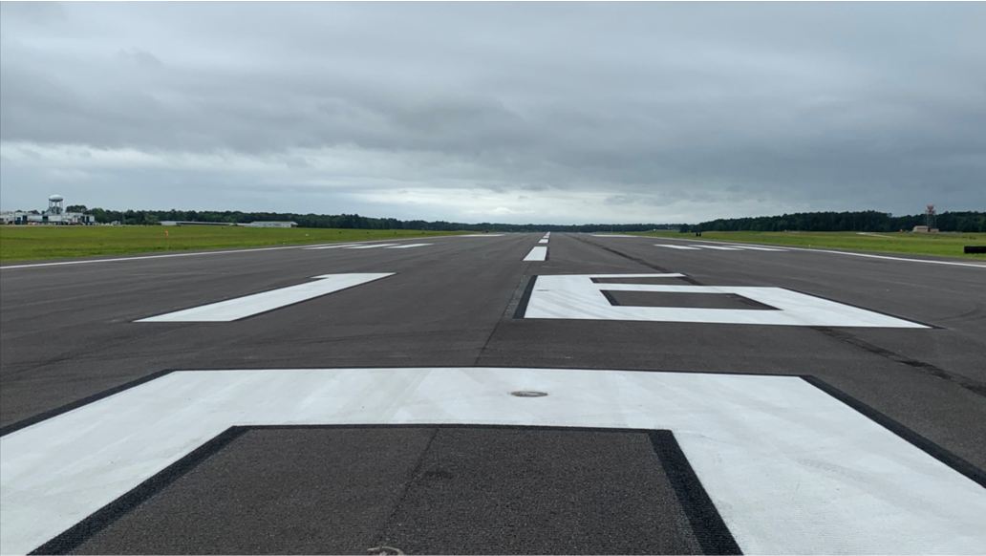
Pre-Submission Conference: ON-CALL PROFESSIONAL CONSULTING SERVICES TO DESIGN AND ENGINEER JMAA PROJECTS AT JACKSON-MEDGAR WILEY EVERS INTERNATIONAL AIRPORT (JAN) AND HAWKINS FIELD AIRPORT (HKS)
2023-11-15
JMAA PROJECT NUMBER 002-24
1
Notes:
Mr. Williams and hands to Pat or David on slide 6

Slide 2
AGENDA
Outline of RFQ Conference
Introduction
Overview
Anticipated Services
Selection Criteria
Schedule
Statement of Qualification (SOQ)
Badging
Tour of JAN and HKS (in person only)

Slide 3
AVAILABLITY
Advertisement Date | Media
November 1, 2023 through November 14, 2023 | La Noticia MS
November 1, 2023 through November 14, 2023 | Rankin County News
November 2, 2023 through November 15, 2023 | Jackson Advocate
November 2, 2023 through November 15, 2023 | Mississippi Link
November 3, 2023 | American Association of Airport Executives Website (https://www.aaaedocs.org/publications/business_opportunities)
November 3, 2023 | Airport Minority Advisory Council (AMAC) Website (https: www.amac-org.com)
November 3, 2023 | Airports Council International – North America (ACI-NA) Website (http://airportscouncil.org/rfp-list)
Full RFQ is published on the following seven media sites and the airport website under the "Partner With US" tab and then under Procurement tab: Procurement | JAN (jmaa.com)
This presentation will be placed on the website with all other procurement documentation.

Slide 4
Facts about JAN
#1 Airport in the State of Mississippi
1.31 million passengers expected in CY 2024
Rated the top 10 for favorite airports in the USA (Travel and Leisure Magazine, 2023
28 daily non-stop commercial flights to 8 world-class hub airports
Atlanta
Baltimore/Washington
Charlotte
Dallas/Ft. Worth
Houston-Intercontinental
Orlando-International
Washington-National

Slide 5
Facts about HKS
Jackson's first historic airport
Welcomed the first commercial flight by Delta Airlines in 1929
Two emergency response medical transport companies
U.S. Air Force Auxiliary, MS Civil Air Patrol
Hawkins Jet Center FBO
Mississippi Army National Guard 185th Aviation Brigade base. Home to Blackhawks

Slide 6
RFQ
OVERVIEW
Notes:
Pat or David start presentation

Slide 7
REASON FOR RFQ
The procurement action is required by the FAA.
Procurement action is following the guidance in AC 150/5100-14E
Required in order for the airport to receive funding from the FAA through AIP and from the State
This is QUALIFICATION BASED selection. NO mention of price shall be made in your submission.

Slide 8
CONTRACT TERM
Three (3) year initial contract with option for two (2) one (1) year options.
Two (2) A/E contracts will be awarded

Slide 9
ANTICIPATED SERVICES
Task Orders issued under the Professional Services Agreement may include but not limited to the following services:
Airport engineering
Architectural design
Construction management services for both AIP (Airport Improvement Program) and non-federally funded projects

Slide 10
ANTICIPATED AIP Projects
Rehabilitation Taxiways
Runway Improvements
Architectural design
Construction management
Master Plan light forecast
Airfield Draingage
Lighting
Terminal Study
Notes:
Refer to ACIP document

Slide 11
Possible NOFO FUNDED SERVICES
Jet Bridge Rehabilitation
Elevators
HVAC System
Generators
Baggage Belt
Escalators

Slide 12
CRITERIA FOR SELECTION Standard Selection Process – RFQ
Selection Criteria | Total Point Value Available
Experience | 25
Qualifications | 15
DBE Participation | 20
Capacity | 20
Organization of Submission | 20
Total | 100

Slide 13
CRITERIA 1: EXPERIENCE
Direct professional project experience with projects similar in type, scope, and complexity

Slide 14
CRITERIA 2: QUALIFICATIONS
Professional licensure as required by the scope of project

Slide 15
CRITERIA 3: DBE PARTICIPATION
An OVERALL DBE participation goal is currently 30%
This is an OVERALL goal…you are encouraged to exceed the goal
Pay Close Attention to Exhibit 3
Include Exhibit 4,5,6 as part of its RFQ.
Notes:
Introduce Mrs. Hendricks

Slide 16
CRITERIA 4: CAPACITY
Exhibited by Proposed Project Plan
Schedule
Timeline for Completion
Key staff resumes

Slide 17
CRITERIA 5: ORGANIZATION OF SUBMISSION
Clarity of submission & all required documents.

Slide 18
SCHEDULE
TASK | COMPLETION DATE | STATUS
Advertise RFQs | November 1, 2023 | ARRIVED
Addendum 1 | November 3, 2023 | Published
Pre-Submission Meeting | November 15, 2023 | ARRIVED
Final Date for Questions | November 28, 2023 | On -Time
RFQ Submission Deadline | January 10, 2024 | On-Time
Notes:
Note – Addendum will be issued due to change of submission to JMAA.bids

Slide 19
Statement of Qualifications (SOQ)

Slide 20
STATEMENT ORGANIZATION
Organize your Statement in sections to the review criteria included in the RFQ
Statements are limited to 15 pages in length, excluding letters of interest, DBE forms, audited financial statements, and required forms.
Single-sided only
The preferred method for receiving responses is via electronic submission at www.jmaabids.com
NO smaller than 11 font size
The Evaluation Committee will not review any information outside of these guidelines.

Slide 21
STATEMENT SUBMISSION
INSTRUCTIONS FOR ELECTRONIC SUBMISSIONS
The following information applies to all proposals. The preferred method for receiving responses is via electronic submission at www.jmaabids.com
**** Continued ***

Slide 22
STATEMENT SUBMISSION
Log in at www.jmaabids.com and perform the following steps:
A. Scan all required documentation as a PDF file.
B. On the left side of the webpage, click on “Public bids.”
C. Click on the appropriate bid that you will be participating in.
D. Click on the “Submit Bid” tab.
1. Fill in your profile information (or check for accuracy if auto-populated).
2. Under the “FDF Attachments section,” Drag and drop your pdf file into the box as outlined or click on the “click here” link inside the submission box to find your file.
3. Under the “Review and Verify” section, click the box agreeing to the terms and conditions.
4. Click “Submit” when you are ready to submit your file.
5. You will receive confirmation when your response has been submitted. If you do not receive a response, your submission has not been received. If you have questions about whether the response was received, you can contact cory@phbidding.com or call 662-407-0193.
E. Once submitted and the solicitation period has ended, Jackson Municipal Airport Authority will review all solicitations and choose the bid that best meets the needs of JMAA.
F. The bid submission can be redacted at any time prior to the bid opening time.
Notes:
You will receive confirmation when your response has been submitted. If you do not receive a response, your submission has not been received. If you have questions about whether the response was received, you can contact cory@phbidding.com or call 662-407-0193.

Slide 23
PHASES TO SELECTION
Phase 0:
Initial review of responsiveness
Phase 1:
Evaluation Committee Scoring
Completed independently, the committee will convene to tally scoring and discuss proposals. Recommend shortlist.
Phase 2:
Interviews
Will help only if two or more firms are shortlisted
Two –week notice provided to short-listed firms.
Phase 3 :
AWARD two (2) firms

Slide 24
RFQ CHECKLIST
Exhibit 1 – SIGNATURE and NOTARY required
Exhibit 2 – Signature required
Exhibit 4 – Signature required
Exhibit 5 – Signature required
Exhibit 6 - Signature required
Exhibit 8 –Signature required
Exhibit 9 - Signature required
Exhibit 12 – Signature required
Acknowledgment of any Addenda Issued in this RFQ- Signature Required

Slide 25
BADGING
Types of badges and the applicability of each specific to the area of work:
Green Badge – Public area access only (Security Threat Assessment or STA requirement)​
White Badge – Sterile area access only (concourses/restaurant vendors)​
Orange Badge – SIDA area access only (Requires STA and CHRC background check)​
Blue Badge – All area access (Requires STA and CHRC check)
Notes:
Introduce Tonya Coakley

Slide 26
QUESTIONS & ANSWERS

Slide 27
Pre-Submission Conference: ON-CALL PROFESSIONAL CONSULTING SERVICES TO DESIGN AND ENGINEER JMAA PROJECTS AT JACKSON-MEDGAR WILEY EVERS INTERNATIONAL AIRPORT (JAN) AND HAWKINS FIELD AIRPORT (HKS)
Questions
Contact:
Mr. Eric Williams
ewilliams@jmaa.com
JMAA PROJECT NUMBER 002-24
Notes:
All questions to Mr. Williams

